Slide 1
Sample Lecture Presentation
Perkins eLearning Instructors use presentations like these to present weekly lectures
Open the presentation to “slide show” view to activate links

Slide 2
Sample slide with links
http://www.aaiddjournals.org/
“What is the Expanded Core Curriculum?” AFB and Perkins School for the Blind.
Retrieved from: http://www.eccadvocacy.org/section.aspx?FolderID=13
Autism Society resources

Slide 3
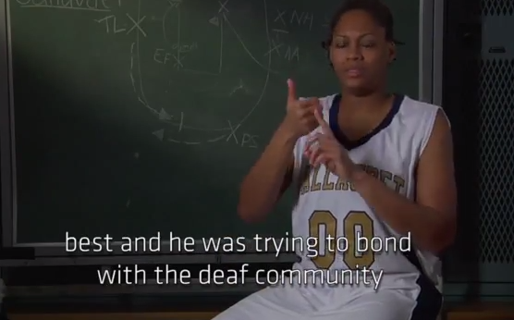
Slide with video
Watch the video clip on Galludet Basketball and outline the strategy used by coach cook to communicate with his players.

Slide 4
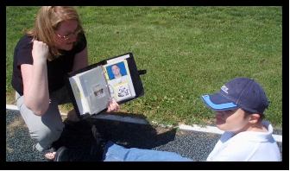
Slide with images

Slide 5
Sample with chart

